Slide 1
Lecture 8
Testability Measures
Origins
Controllability and observability
SCOAP measures
  Sources of correlation error
  Combinational circuit example
  Sequential circuit example
Test vector length prediction
High-Level testability measures
Summary

Slide 2
Purpose
Need approximate measure of:
  Difficulty of setting internal circuit lines to 0 or 1 by setting primary circuit inputs
  Difficulty of observing internal circuit lines by observing primary outputs
Uses:
  Analysis of difficulty of testing internal circuit parts – redesign or add special test hardware
  Guidance for algorithms computing test patterns – avoid using hard-to-control lines
  Estimation of fault coverage
  Estimation of test vector length

Slide 3
Origins
Control theory
Rutman 1972 -- First definition of controllability
Goldstein 1979 -- SCOAP
  First definition of observability
  First elegant formulation
  First efficient algorithm to compute controllability and observability
Parker & McCluskey 1975
  Definition of Probabilistic Controllability
Brglez 1984 -- COP
  1st probabilistic measures
Seth, Pan & Agrawal 1985 – PREDICT
  1st exact probabilistic measures

Slide 4
Testability Analysis
Involves Circuit Topological analysis, but no
test vectors and no search algorithm
  Static analysis
Linear computational complexity
  Otherwise, is pointless – might as well use
  automatic test-pattern generation and
  calculate:
    Exact fault coverage
    Exact test vectors

Slide 5
Types of Measures
SCOAP – Sandia Controllability and Observability Analysis Program
Combinational measures:
  CC0 – Difficulty of setting circuit line to logic 0
  CC1 – Difficulty of setting circuit line to logic 1
  CO – Difficulty of observing a circuit line
Sequential measures – analogous:
  SC0
  SC1
  SO

Slide 6
Range of SCOAP Measures
Controllabilities – 1 (easiest) to infinity (hardest)
Observabilities – 0 (easiest) to infinity (hardest)
Combinational measures:
  Roughly proportional to # circuit lines that must be set to control or observe given line
Sequential measures:
  Roughly proportional to # times a flip-flop must be clocked to control or observe given line

Slide 7
Goldstein’s SCOAP Measures
AND gate O/P 0 controllability:
output_controllability = min (input_controllabilities)
+ 1
AND gate O/P 1 controllability:
output_controllability = Σ (input_controllabilities)
+ 1
XOR gate O/P controllability
  output_controllability = min (controllabilities of
  each input set) + 1
Fanout Stem observability:
  Σ or min (some or all fanout branch observabilities)

Slide 8
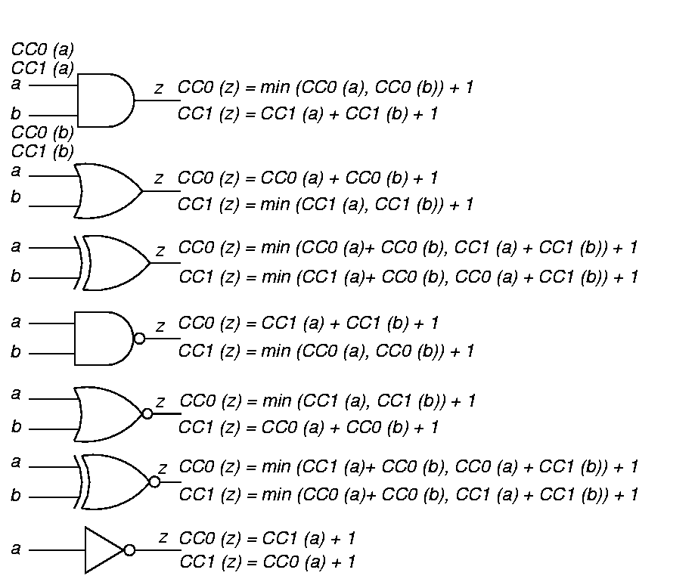
Controllability Examples

Slide 9
More Controllability
Examples

Slide 10
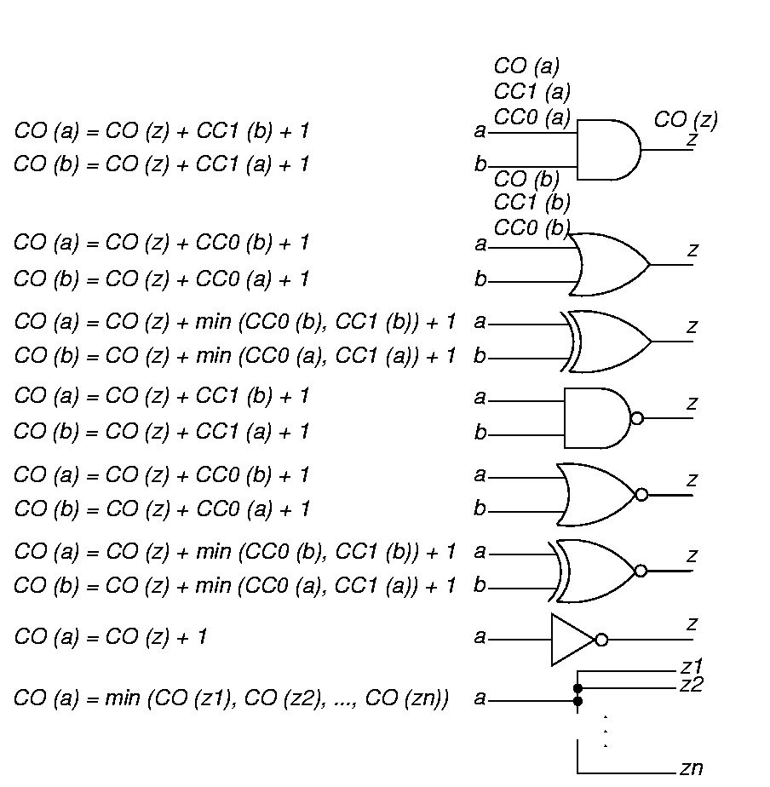
Observability Examples
To observe a gate input:
Observe output and make other input values non-controlling

Slide 11
More Observability Examples
To observe a fanout stem:
Observe it through branch with best observability

Slide 12
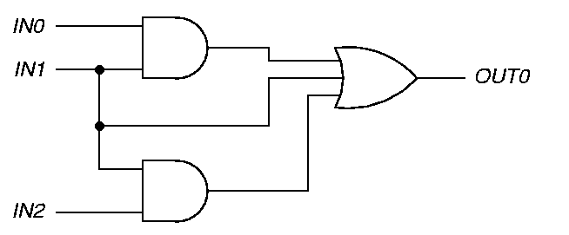
Error Due to Stems & Reconverging Fanouts
SCOAP measures wrongly assume that controlling or observing x, y, z are independent events
  CC0 (x), CC0 (y), CC0 (z) correlate
  CC1 (x), CC1 (y), CC1 (z) correlate
  CO (x), CO (y), CO (z) correlate
x
y
z

Slide 13
Correlation Error Example
Exact computation of measures is NP-Complete and impractical
Italicized (green) measures show correct values – SCOAP measures are in red or bold CC0,CC1 (CO)
1,1(6)
1,1(5, )
2,3(4)
2,3(4, )
x
8
8
6,2(0)
4,2(0)
(6)
(5)
(4,6)
1,1(5)
1,1(4,6)
y
(6)
2,3(4)
2,3(4, )
8
z
1,1(6)
1,1(5, )
8

Slide 14
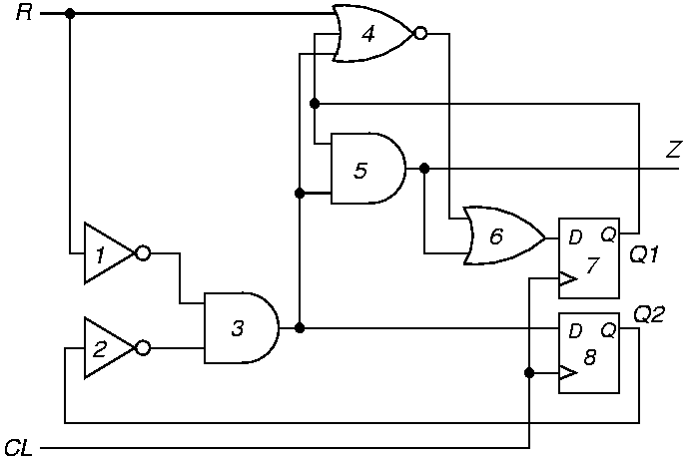
Sequential Example

Slide 15
Levelization Algorithm 6.1
Label each gate with max # of logic levels from primary inputs or with max # of logic levels from primary output
Assign level # 0 to all primary inputs (PIs)
For each PI fanout:
  Label that line with the PI level number, &
  Queue logic gate driven by that fanout
While queue is not empty:
  Dequeue next logic gate
  If all gate inputs have level #’s, label the gate with the maximum of them + 1;
  Else, requeue the gate

Slide 16
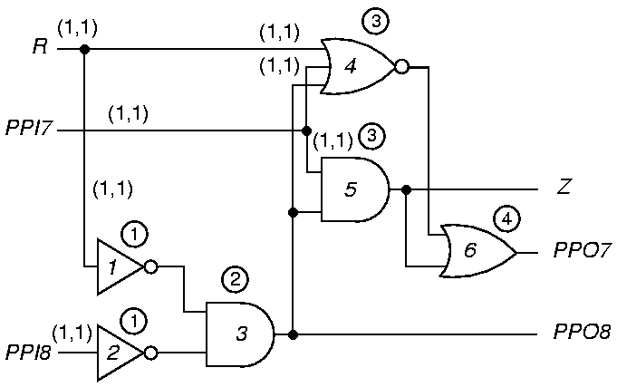
Controllability Through Level 0
Circled numbers give level number. (CC0, CC1)

Slide 17
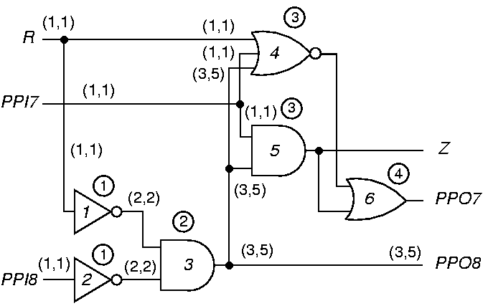
Controllability Through Level 2

Slide 18
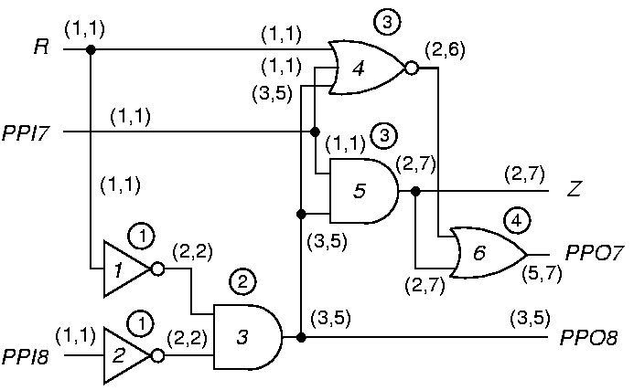
Final Combinational Controllability

Slide 19
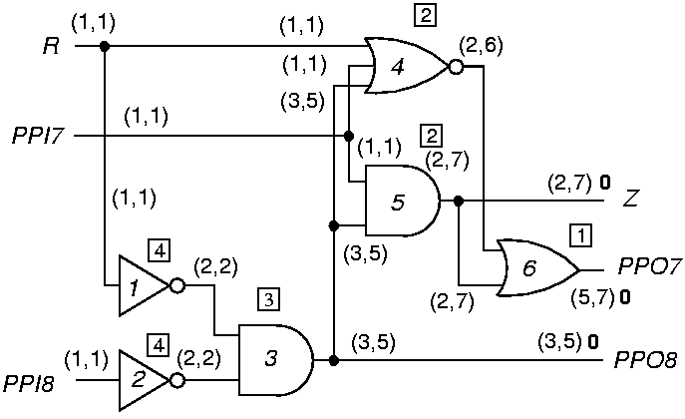
Combinational Observability for Level 1
Number in square box is level from primary outputs (POs).
(CC0, CC1) CO

Slide 20
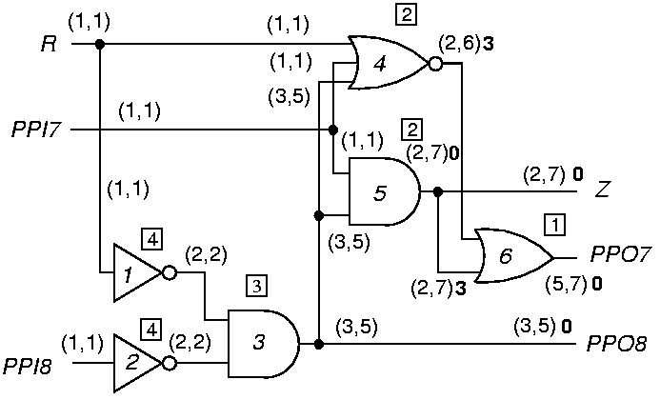
Combinational Observabilities for Level 2

Slide 21
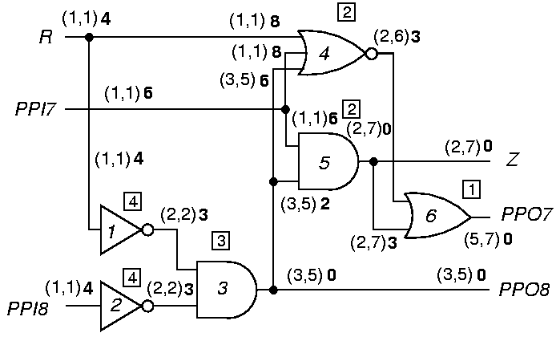
Final Combinational Observabilities

Slide 22
Sequential Measure Differences
Combinational
  Increment CC0, CC1, CO whenever you pass through a gate, either forwards or backwards
Sequential
  Increment SC0, SC1, SO only when you pass through a flip-flop, either forwards or backwards, to Q, Q, D, C, SET, or RESET
Both
  Must iterate on feedback loops until controllabilities stabilize

Slide 23
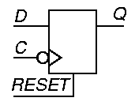
D Flip-Flop Equations
Assume a synchronous RESET line.
CC1 (Q) = CC1 (D) + CC1 (C) + CC0 (C) + CC0
(RESET)
SC1 (Q) = SC1 (D) + SC1 (C) + SC0 (C) + SC0
(RESET) + 1
CC0 (Q) = min [CC1 (RESET) + CC1 (C) + CC0 (C),
CC0 (D) + CC1 (C) + CC0 (C)]
SC0 (Q) is analogous
CO (D) = CO (Q) + CC1 (C) + CC0 (C) + CC0
(RESET)
SO (D) is analogous

Slide 24
D Flip-Flop Clock and Reset
CO (RESET) = CO (Q) + CC1 (Q) + CC1 (RESET) +
CC1 (C) + CC0 (C)
SO (RESET) is analogous
Three ways to observe the clock line:
  Set Q to 1 and clock in a 0 from D
  Set the flip-flop and then reset it
  Reset the flip-flop and clock in a 1 from D
CO (C) = min [ CO (Q) + CC1 (Q) + CC0 (D) +
CC1 (C) + CC0 (C),
CO (Q) + CC1 (Q) + CC1 (RESET) +
CC1 (C) + CC0 (C),
CO (Q) + CC0 (Q) + CC0 (RESET) +
CC1 (D) + CC1 (C) + CC0 (C)]
SO (C) is analogous

Slide 25
Algorithm 6.2
Testability Computation
For all PIs, CC0 = CC1 = 1 and SC0 = SC1 = 0
For all other nodes, CC0 = CC1 = SC0 = SC1 =
Go from PIs to POs, using CC and SC equations to get controllabilities -- Iterate on loops until SC stabilizes -- convergence guaranteed
Set CO = SO = 0 for POs, for all other lines
Work from POs to PIs, Use CO, SO, and controllabilities to get observabilities
Fanout stem (CO, SO) = min branch (CO, SO)
If a CC or SC (CO or SO) is , that node is uncontrollable (unobservable)
8
8

Slide 26
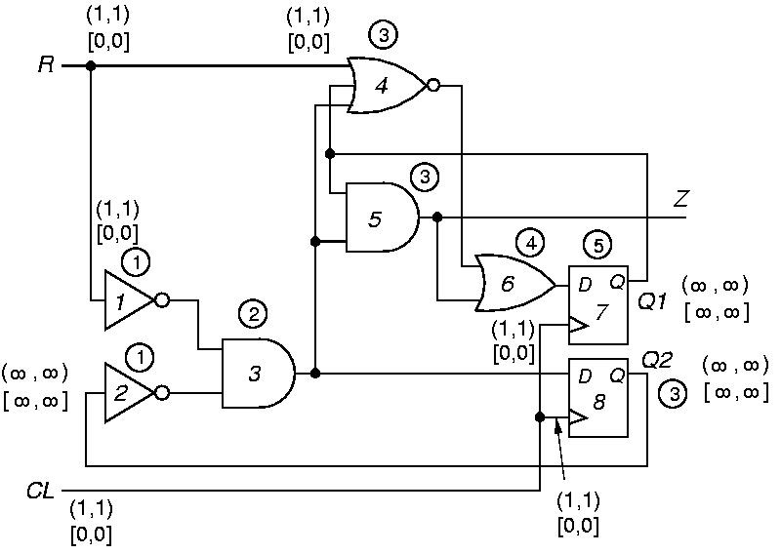
Sequential Example Initialization

Slide 27
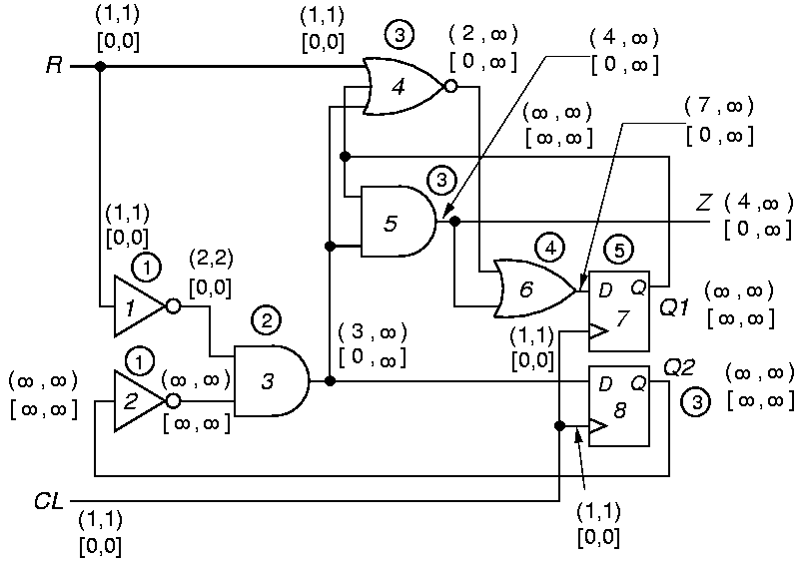
After 1 Iteration

Slide 28
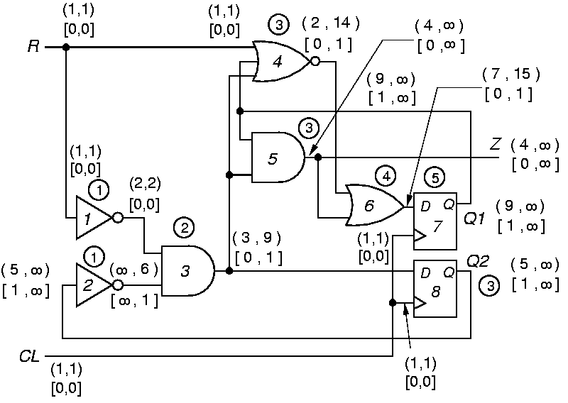
After 2 Iterations

Slide 29
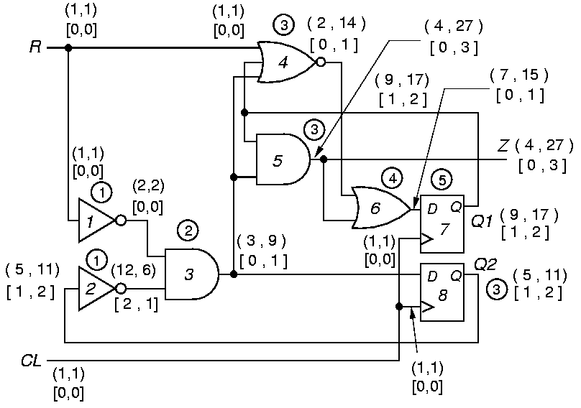
After 3 Iterations

Slide 30

Stable Sequential Measures

Slide 31
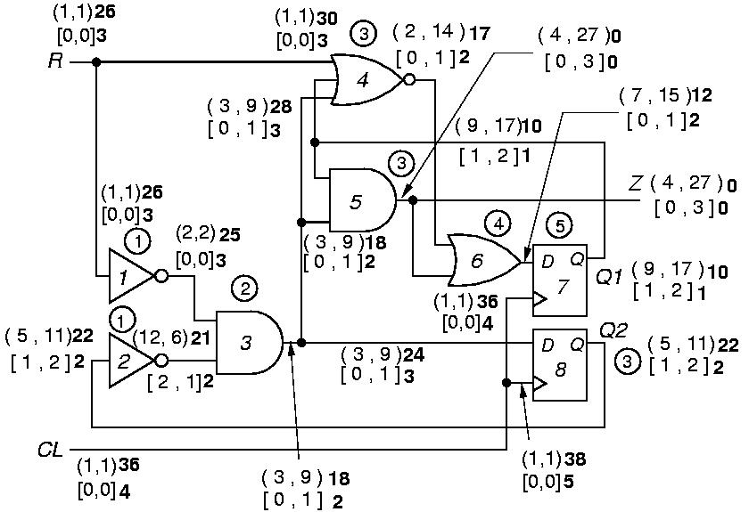
Final Sequential Observabilities

Slide 32
Test Vector Length Prediction
First compute testabilities for stuck-at faults
  T (x sa0) = CC1 (x) + CO (x)
  T (x sa1) = CC0 (x) + CO (x)
  Testability index = log Σ T (f _{i})
f_{i}

Slide 33
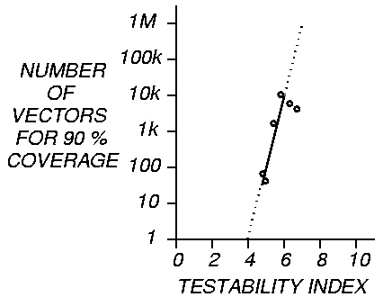
Number Test Vectors vs. Testability Index

Slide 34
High Level Testability
Build data path control graph (DPCG) for circuit
Compute sequential depth -- # arcs along path
between PIs, registers, and POs
Improve Register Transfer Level Testability with
redesign

Slide 35
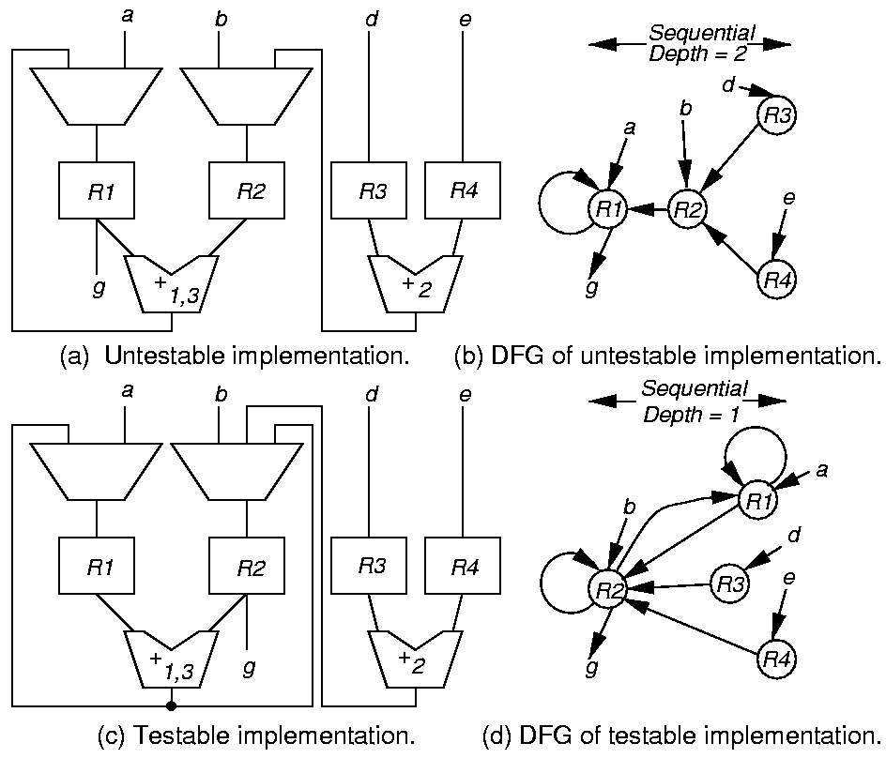
Improved RTL Design

Slide 36
Summary
Testability approximately measures:
  Difficulty of setting circuit lines to 0 or 1
  Difficulty of observing internal circuit lines
Uses:
  Analysis of difficulty of testing internal circuit parts
    Redesign circuit hardware or add special test hardware where measures show bad controllability or observability
  Guidance for algorithms computing test patterns – avoid using hard-to-control lines
  Estimation of fault coverage – 3-5 % error
  Estimation of test vector length

